Slide 1
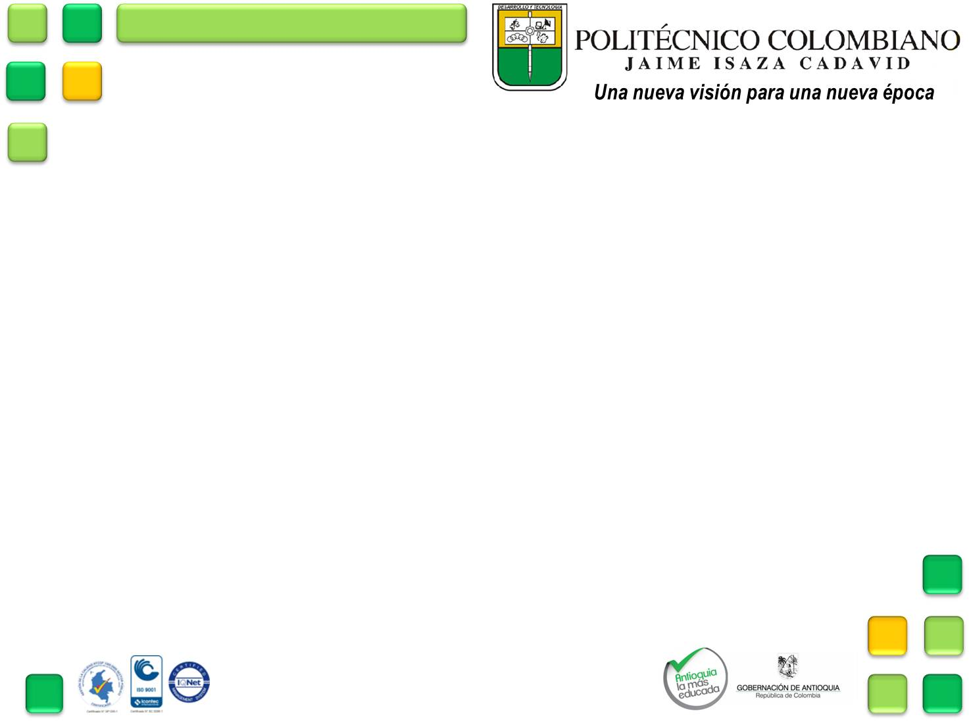
BUILDING AND USE OF LANGUAGE JAVA THREADS.
PROJECT: HORSE RACE
MEMBERS:
WILMAR SANTIAGO DUQUE VALENCIA
KEVIN GARCÍA HINCAPIÉ

Slide 2
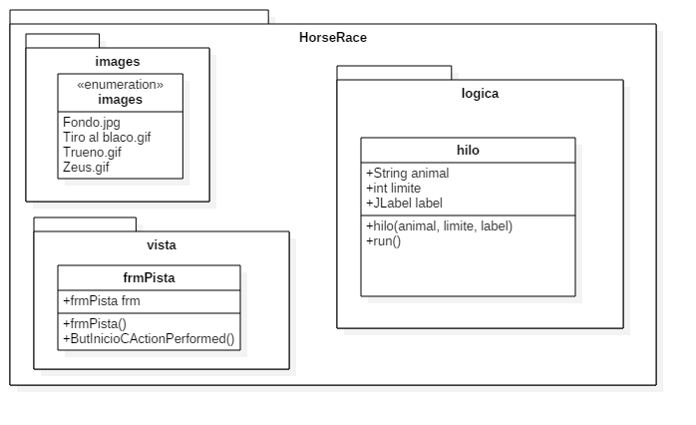
DIAGRAM

Slide 3
BUILDING PROCESS
Final Product.
Code analytics
Code modification
Creating interface.
Application testing.

Slide 4




